Slide 1


Advanced Business Analytics
Group 9
Neerav Talreja, 30
Ayushi Derhgawen, 37

Slide 2
AIM OF THE PROJECT :
Predicting trends of factors which affect happiness index globally
GITHUB LINK :
https://github.com/Ayushi0496/ABA_assignment
DATASET LINK :
https://www.kaggle.com/mathurinache/world-happiness-report

Slide 3
DATASET INFORMATION
Country Name : Name of the country
Regional Indicator : Country’s region
Ladder score: Happiness index
Standard error of ladder score: Standard error of happiness index
Upperwhisker : Ceiling limit of happiness index
Lowerwhisker : Floor limit of happiness index
Logged GDP per capita: GDP per person in a country
Social support: Assistance and care provided by a country
Healthy life expectancy: Average life expectancy of humans in the country
Freedom to make life choices
Generosity: The quality of being kind by the nation’s population
Perceptions of corruption : Perceived levels of public sector corruption
Dystopia : Suffering and injustice in a nation

Slide 4
REASON FOR CHOOSING THE DATASET
The reports sorts countries by their subjective well-being and digs more deeply into how the social, urban and natural environments combine to affect happiness of the nations’ population..
Considers multiple factors related to the happiness index
Provides a global trend and maintains uniformity of data
Data is clean since it is collected by trusted and informed sources
Helps nations to make an improvement in mental health of the population

Slide 5
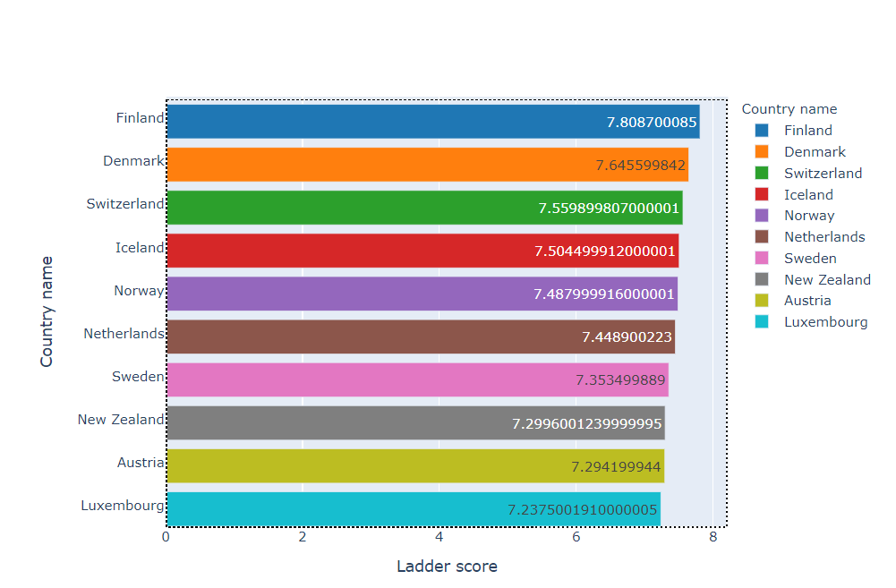
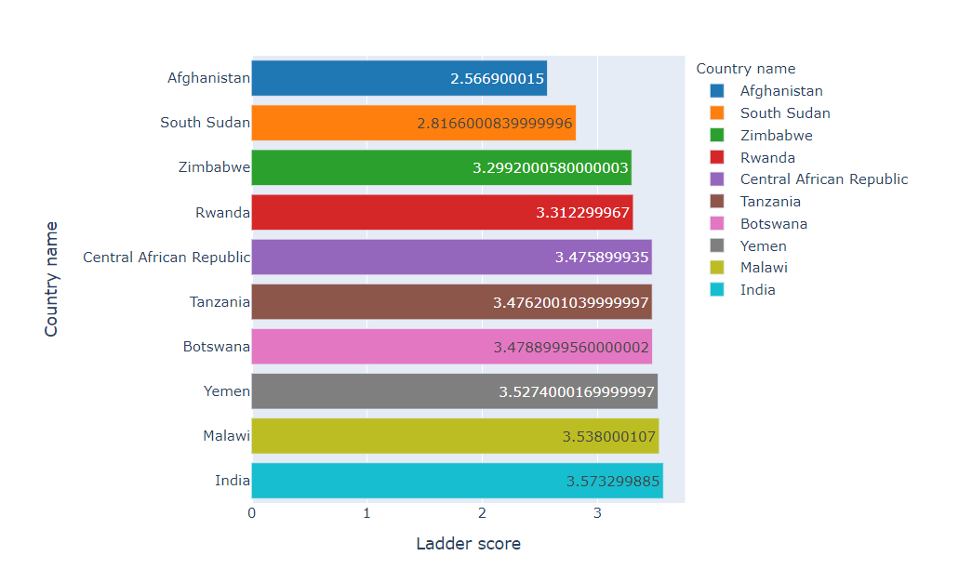
DESCRIPTIVE ANALYTICS ON DATA
The World Happiness Report is a landmark survey of the state of global happiness that ranks 156 countries by how happy their citizens perceive themselves to be.
The following dataset gives us an information about the countries’ happiness index and the various factors related to the happiness score for the year 2020.
The happiest countries as per the data are: Finland, Denmark, Switzerland, Iceland, Norway, Netherlands, Sweden, New Zealand, Austria and Luxembourg
On the contrary, the countries on the bottom of rankings are : India, Malawi, Yemen, Botswana, Tanzania, Central African Republic, Rwanda, Zimbabwe, South Sudan and Afghanistan

Slide 6
LIBRARIES USED
Mathematical Calculations and Interpretation
Pandas
Numpy
Input Output
SKLearn
Data Visualization
matplotlib
seaborn

Slide 7
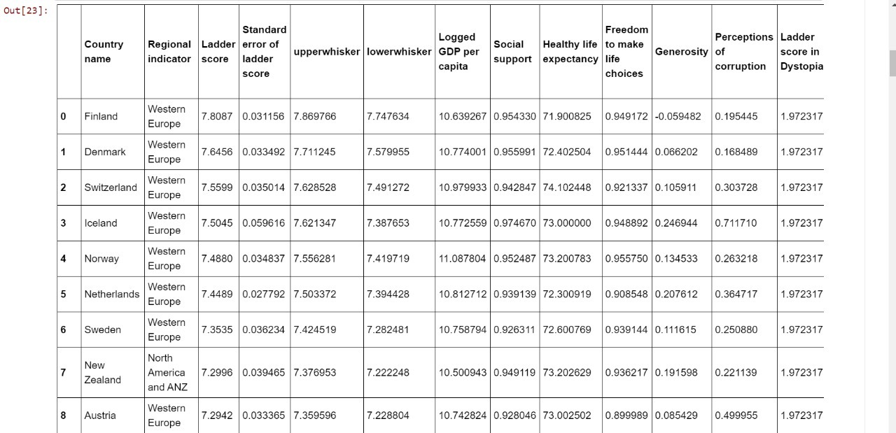
LOADING DATA INTO DATA FRAME
import numpy as np
import pandas as pd
import matplotlib.pyplot as plt
from sklearn.linear_model import LinearRegression
from seaborn import heatmap
from matplotlib import rcParams
import seaborn as sns
df = pd.read_csv(r"2020.csv")
df

Slide 8
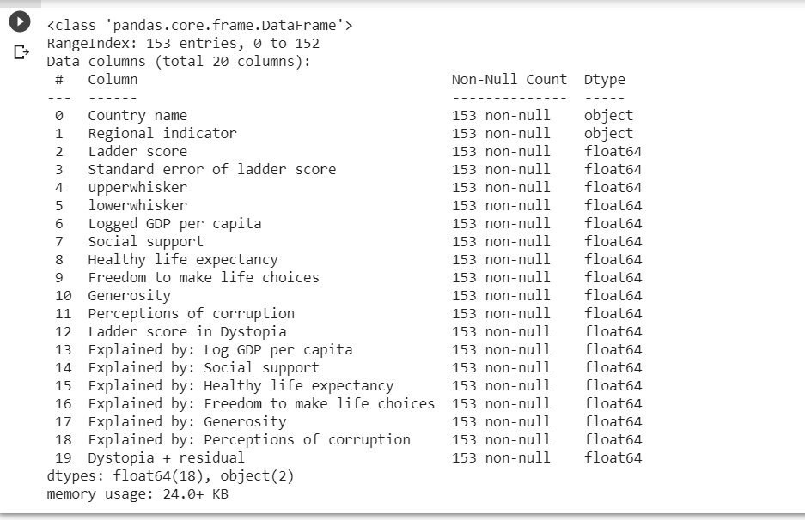
CHECKING THE DATA TYPES
df.info()

Slide 9
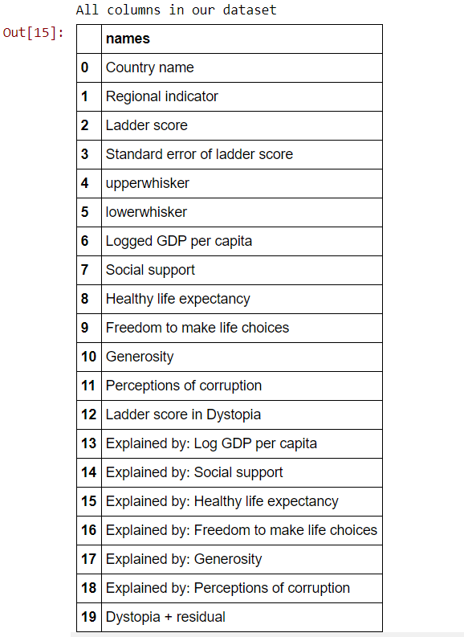
COLOUMNS IN DATASET
columns = df.columns columns_df = pd.DataFrame({"names":columns}) print("All columns in our dataset") columns_df

Slide 10
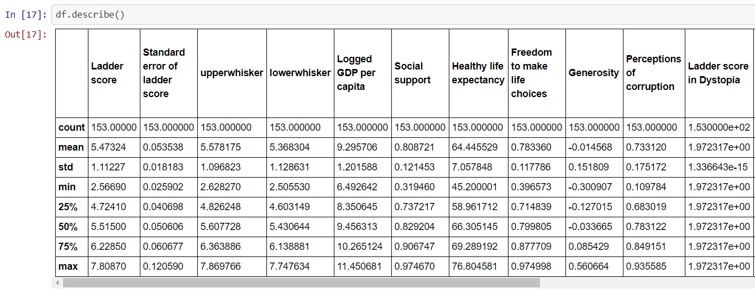
DESCRIPTION OF DATASET
df.describe()

Slide 11
DATA VISUALIZATION

Slide 12
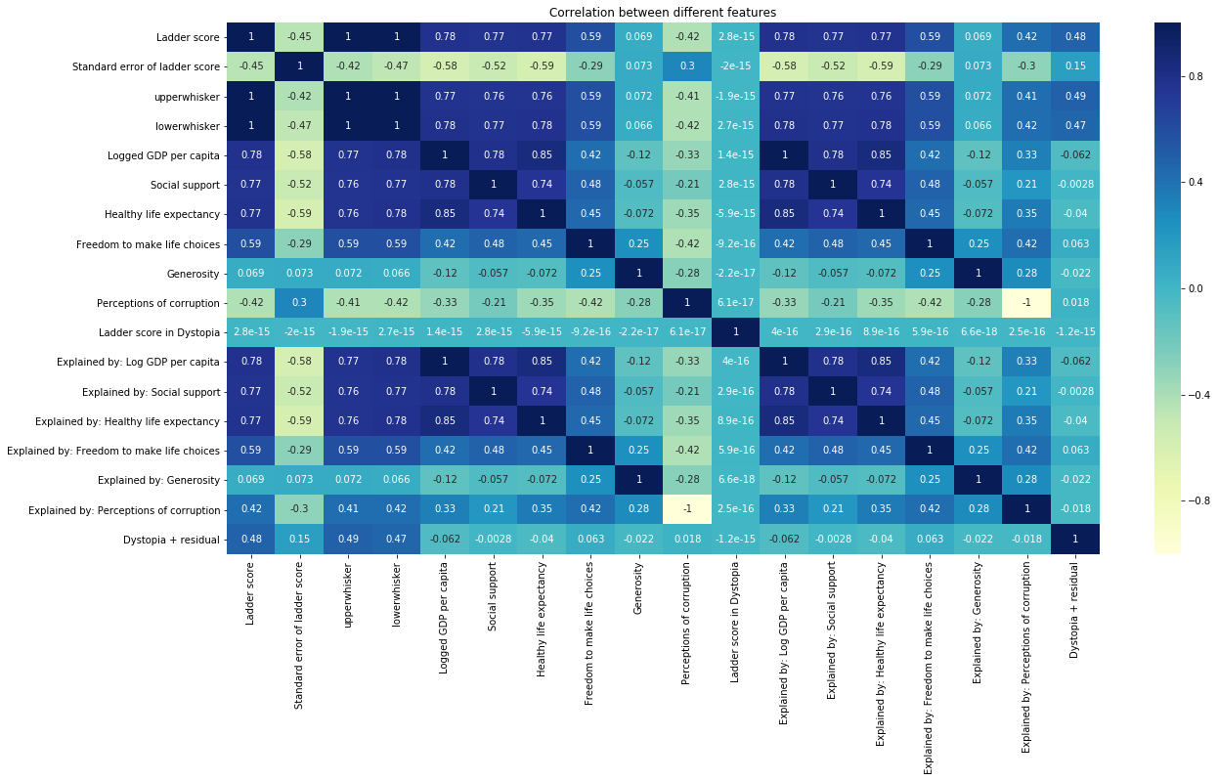
CORRELATION BETWEEN TWO PARAMETERS
df = pd.read_csv(r"2020.csv") rcParams["figure.figsize"] = 20,10 plt.title("Correlation between different features") sns.heatmap(df.corr(),annot=True,cmap="YlGnBu")

Slide 13
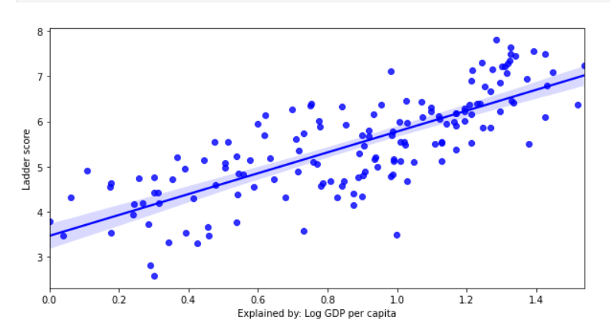
HAPPINESS SCORE VS MULTIPLE FACTORS
cols=['Explained by: Log GDP per capita', 'Explained by: Social support’, 'Explained by: Healthy life expectancy’, 'Explained by: Freedom to make life choices’, 'Explained by: Generosity', 'Explained by: Perceptions of corruption','Dystopia + residual’] for a in cols: plt.figure(figsize=(10,5)) sns.regplot(x=a,y='Ladder score',data=df,color='b’) plt.show()

Slide 14
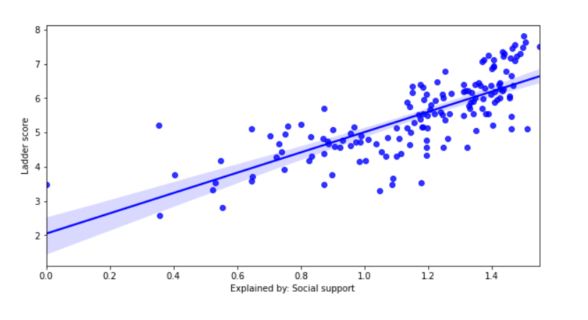
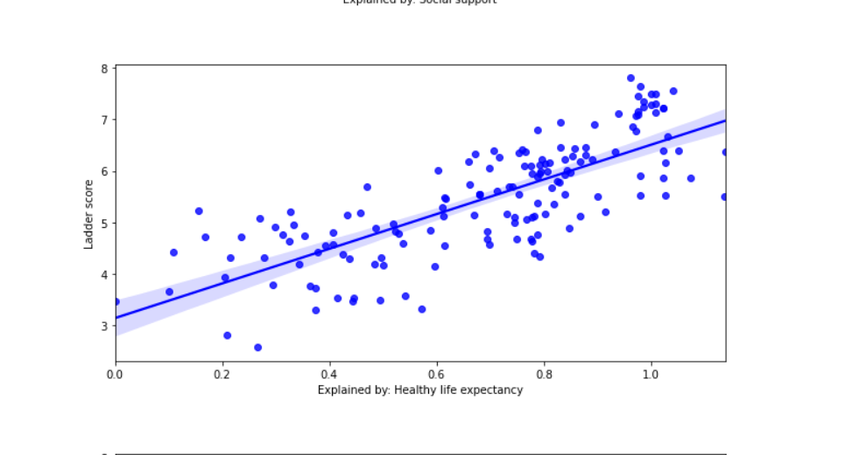

Slide 15
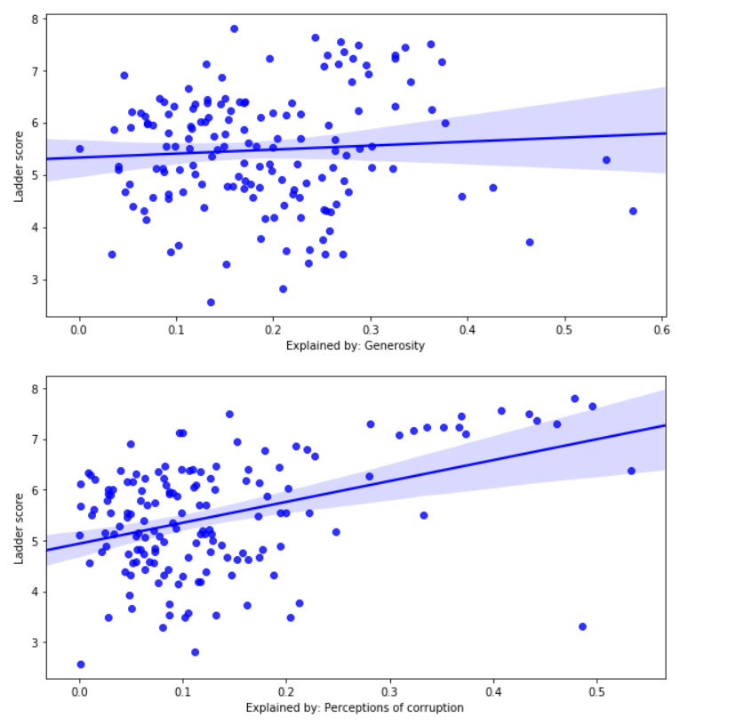
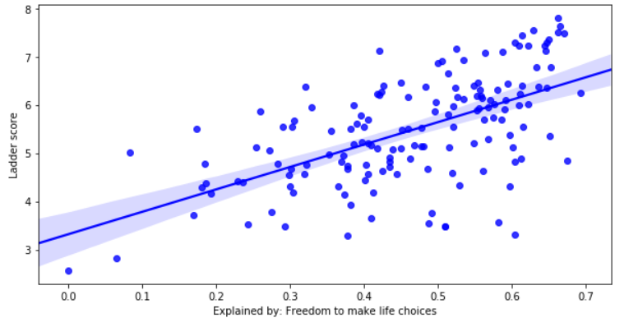
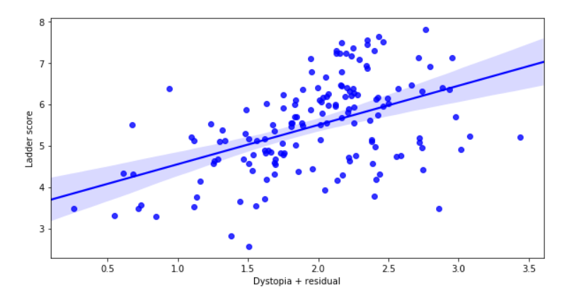

Slide 16
INTERPRETATIONS
CONCLUSION | INSIGHTS FROM ANALYSIS
There is a positive linear correlation between GDP vs Happiness score. However, there quite a few discrepancies that can be observed | Higher GDP does not signify highest happiness nation. Whereas, the lowest GDP score doesn’t signify the lowest happiness index
Similarly, social support shows a high degree of positive correlation and the error is reduced | Higher social support means a better happiness index for the nation
A positive correlation is again observed for healthy life expectations and freedom to make choices. But the data points are scattered | Healthy life expectations and freedom to make choices affect the happiness index but it may or may not be true in all cases
There is low correlation between generosity and happiness score | Generosity may or may not mean a better happiness index
The trends for perceptions of corruption and dystopia have a positive correlation | Perceptions of corruption and dystopia affect the happiness index but the trends are scattered especially for dystopia

Slide 17
FUTURE SCOPE
The following could be used by leaders or politicians everywhere to see which aspects of life would make their citizens the happiest. They can use that data to build their platforms. For example, someone could input some data into the model to get a happiness level then that same person could tweak the life expectancy which should change the happiness level. By doing so, that person can determine how important focusing on each aspect of life is to the people of that country. There's many other applications that could be used here.

